Slide 1
Gaia Project Presented by Zhiyan Wang
Analysis of Tycho-Gaia Astrometric Solution (TGAS) data and its matched data with 2MASS
Gaia: Astrometry of stars (Position, distance, proper motion, etc.)
2Mass: Astronomical survey of sky in the infrared spectrum
Presentations:
Transverse velocity statistics
Density distribution and transverse velocity distribution
Hertzsprung–Russell diagram

Slide 2
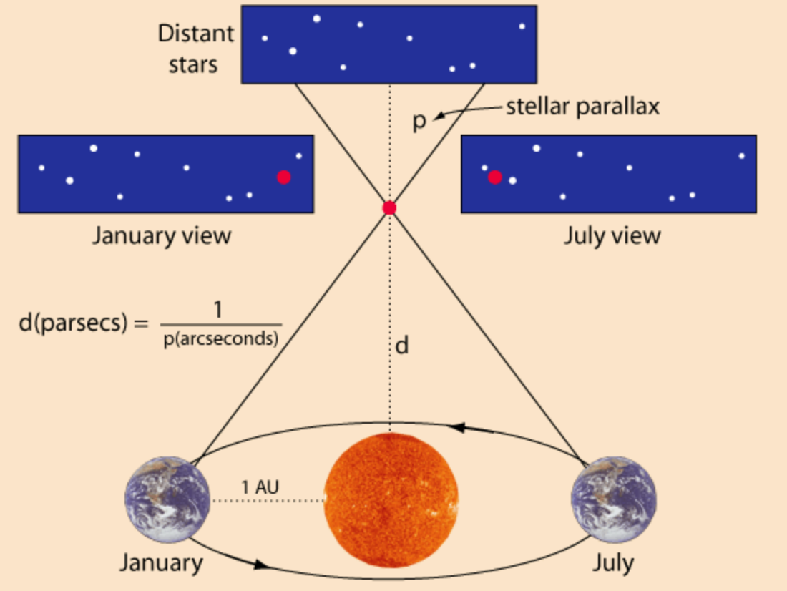
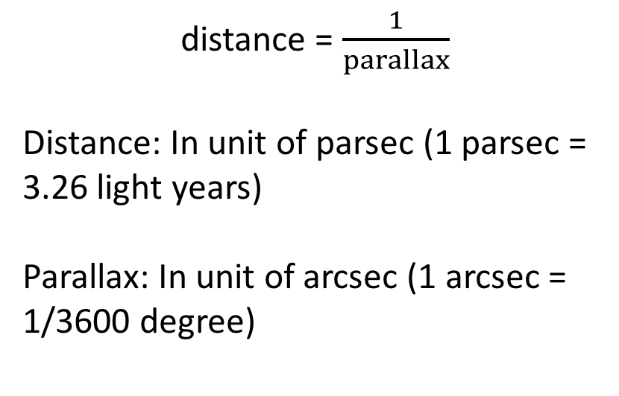
Background: Parallax
distance = $\frac{1}{parallax}$
Distance: In unit of parsec (1 parsec = 3.26 light years)
Parallax: In unit of arcsec (1 arcsec = 1/3600 degree)

Slide 3
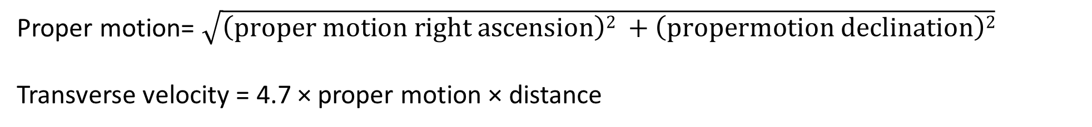
Background: Proper Motion
μ_{α}: proper motion right ascension, μ_{δ}: proper motion declination. Unit: milliarcsec/year
Proper motion= $\sqrt{\left(proper motion right ascension\right)2 +\left(propermotion declination\right)2}$
Transverse velocity = 4.7 × proper motion × distance

Slide 4
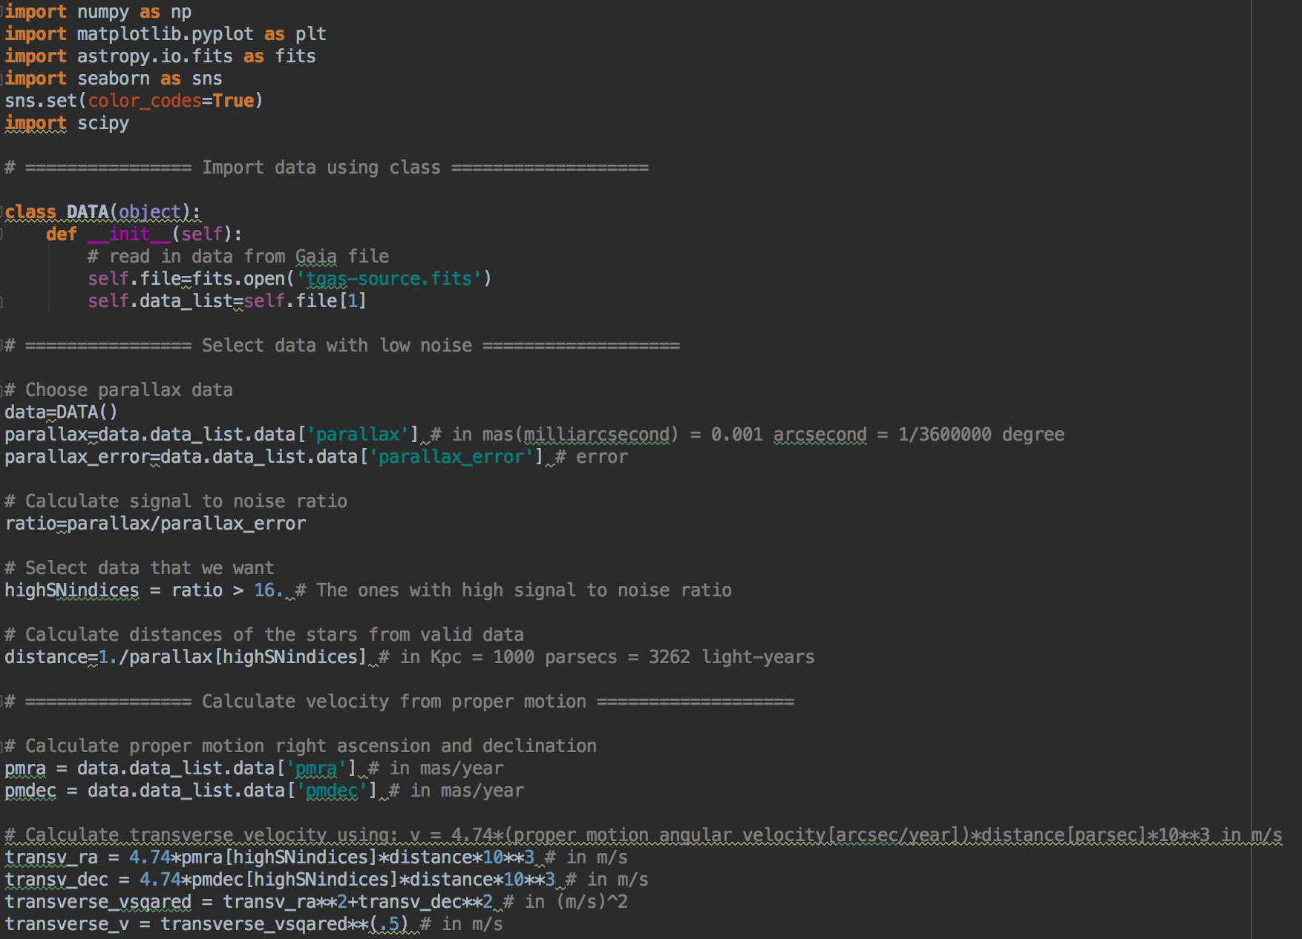

Slide 5
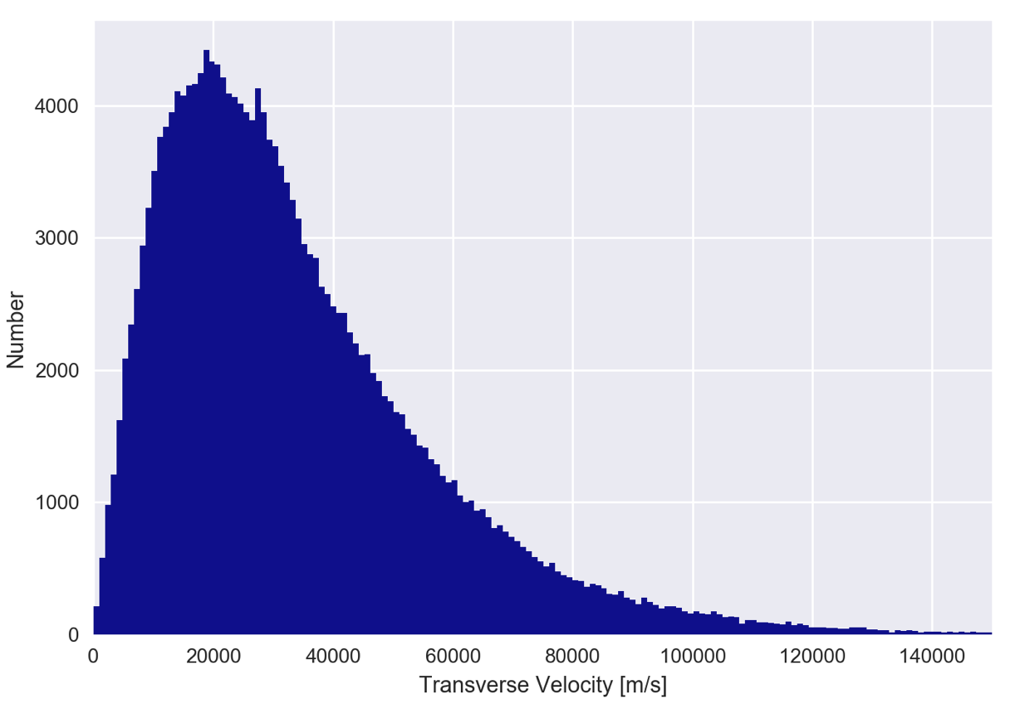
Distribution of Transverse Velocity
This is the histogram of all transverse velocities calculated from proper motion.
The data is measured relatively to the detector.
The peak value is around 18 km/s.
In comparison, the Sun travels around the center of the Milky Way at a speed of about 220 km/s at a radius of 8±0.65 kPc from the center.

Slide 6
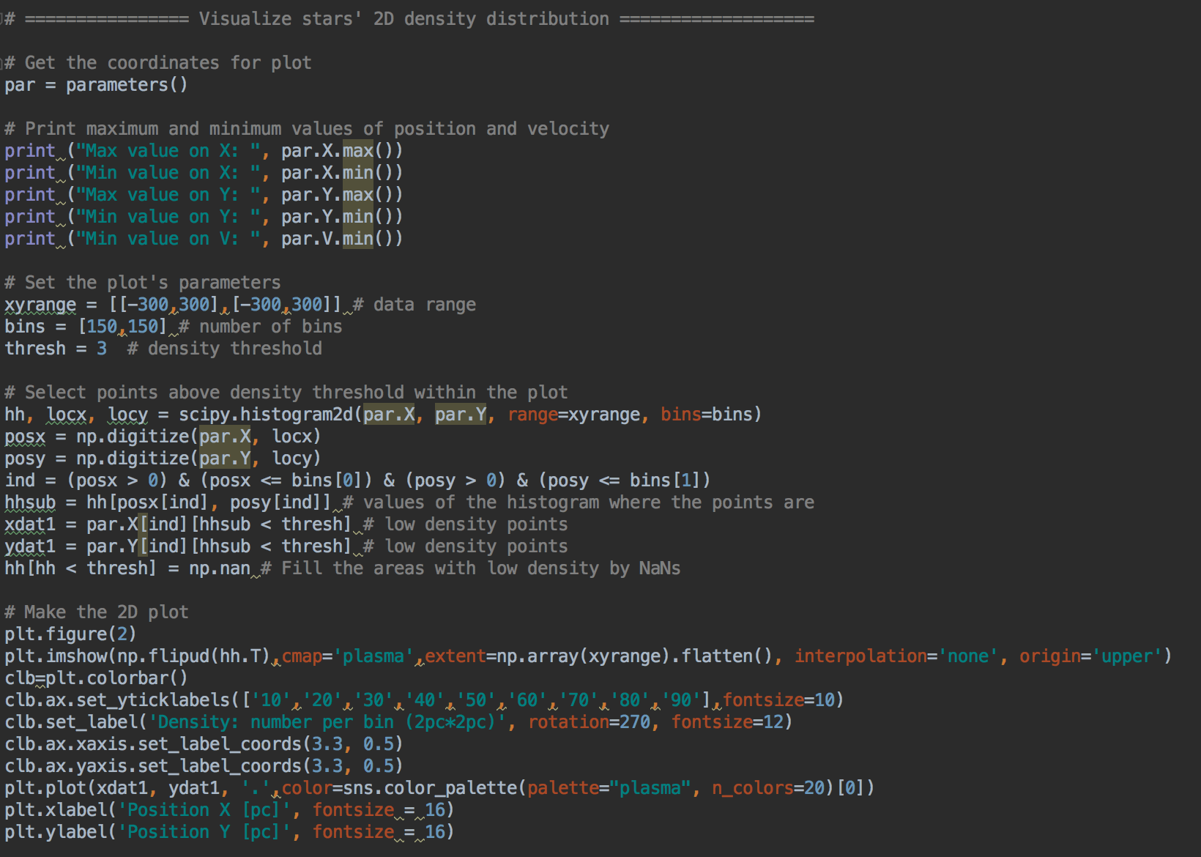

Slide 7
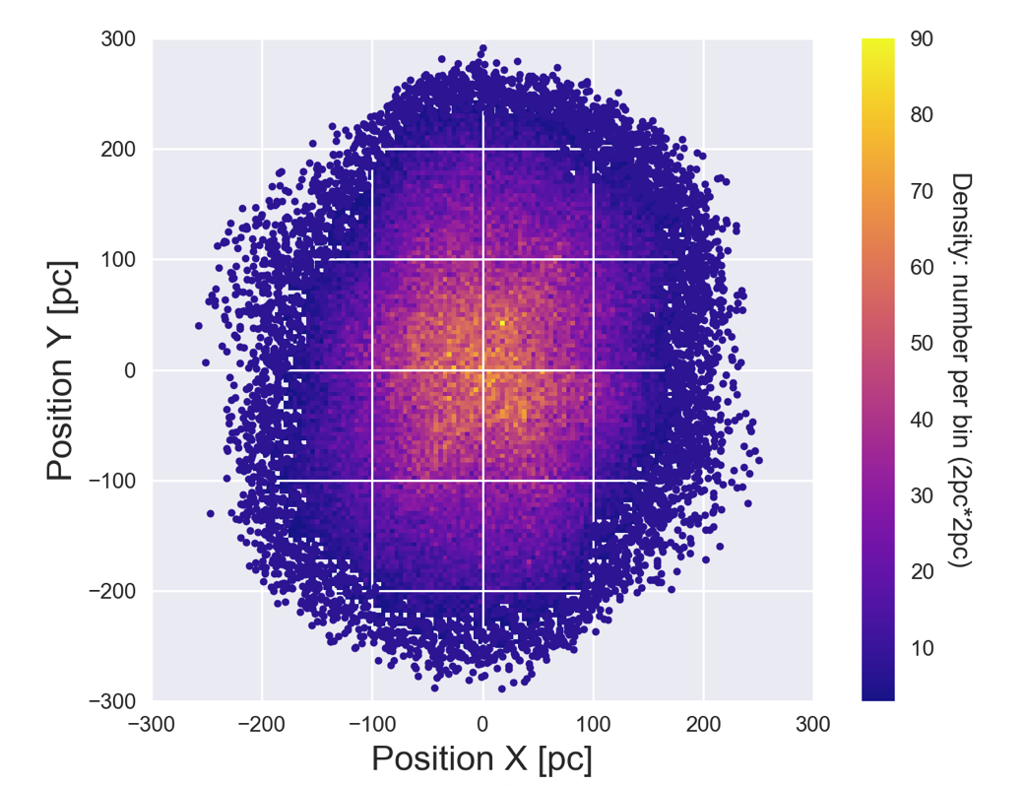
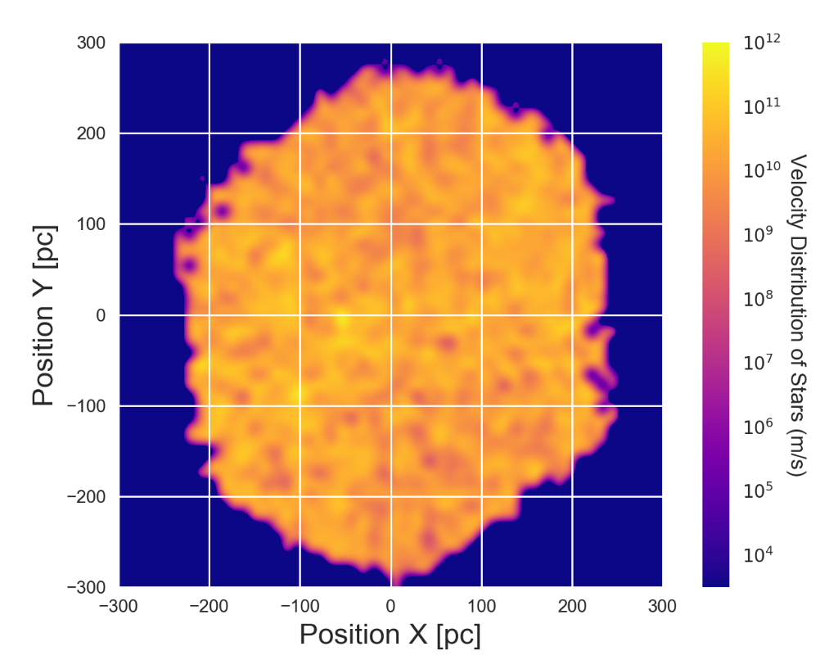
Density Distribution VS. Velocity Distribution
Density of detected stars is higher near the center because of detector resolution
There is no apparent correlation between relative positions and transverse velocities.

Slide 8
Hertzsprung–Russell Diagram
Scatter plot of stars showing the relationship between the stars’ absolute magnitudes and their effective temperature.
Because 2MASS is measuring spectrum around 2-micrometer wavelength, the observed sources, such as brown dwarfs, are expected to have low temperatures.
An observational Hertzsprung–Russell diagram with 22,000 stars plotted from the Hipparcos Catalogue and 1,000 from the Gliese Catalogue of nearby stars.

Slide 9
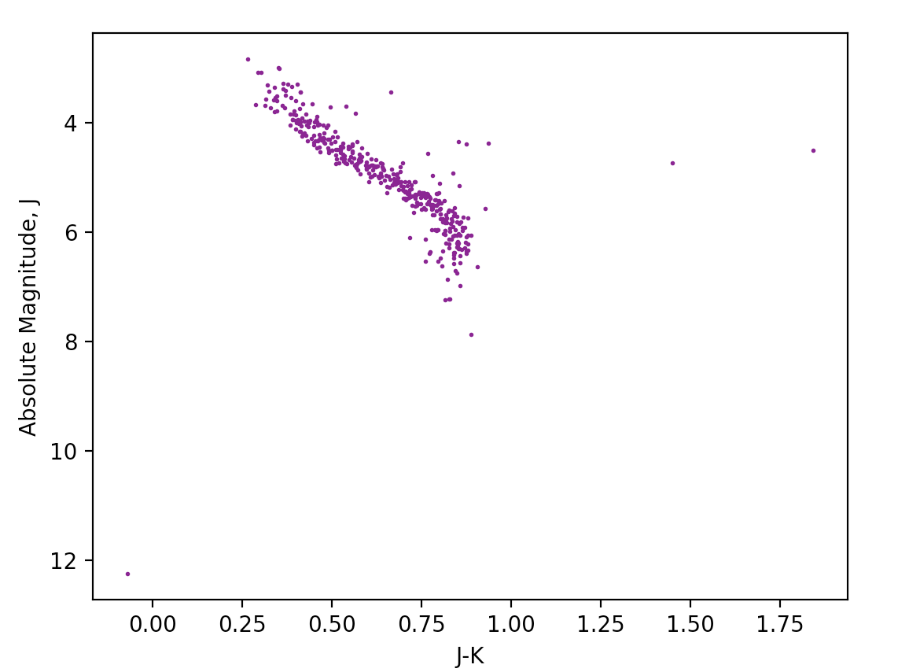
Hertzsprung–Russell Diagram
J-K band spans from 1.25 μm to 2.15 μm, representing the peak wavelength of the measured stars.
According to blackbody radiation, we have:
λ_{peak}T = 2.898 × 10⁻³ m∙K
The temperature of the selected stars (with signal to noise ratio > 128), spans from 1751 K to 2127 K

Slide 10
Thank you!

